Slide 1

Employee Management System
Presented By
Lakkireddy Anusha
Chebrolu Balu
Kasthuri Baradwaj

Slide 2
Agenda
Objective of the Project
ER Diagram and schema explanation
Key analysis questions (use cases)
SQL query results with screenshots or summaries
Final business insights and recommendations
Conclusion
Challenges working on SQL

Slide 3
Objective of the Project
The objective of the Employee Management System project is to design a structured SQL-based system that efficiently manages employee data, job roles, salary details, qualifications, leave records, and payroll processing. The project aims to build a relational database that ensures data accuracy, supports analytical queries, and helps organizations generate useful insights for HR and management decision-making.
.

Slide 4
Problem Statement
The Employee Management System (EMS) is designed to efficiently manage employee information, job roles, departments, payroll, qualifications, and leave records within an organization. The system ensures data integrity through relational tables using foreign keys and cascading actions. It also supports analytical queries to provide insights into workforce distribution, salaries, bonuses, leave patterns, and payroll expenses—streamlining HR operations and decision-making.

Slide 5
e database contains six interconnected tables, each performing a specific function: JobDepartment Stores job roles, departments, and descriptions. The database contains six interconnected tables, each performing a specific function: JobDepartment Stores job roles, departments, and descriptions. SalaryBonus Contains salary, bonus, and annual pay for each job role. Employee Holds employee personal information, contact details, and job assignment. Qualification Maintains qualification, skills, and requirements for each employee’s position. Leaves Tracks employee leave details such as date and reason. Payroll Combines employee, job, salary, and leave data to calculate final payments. Foreign Key Relationships The tables are connected using foreign keys with CASCADE and SET NULL rules to maintain data integrity.
.

Slide 6
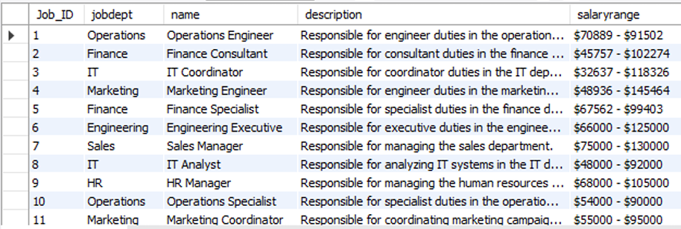
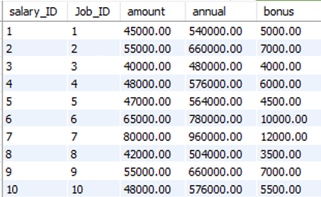
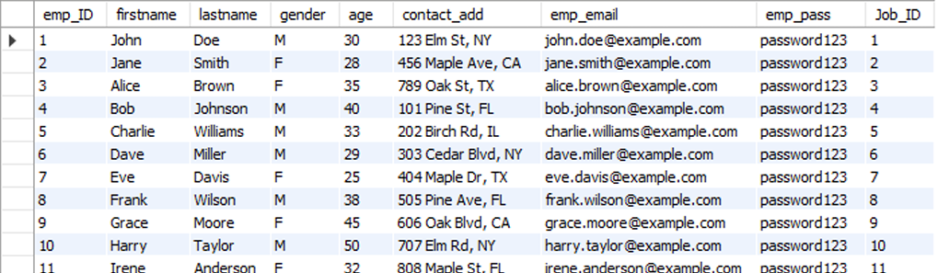
Job Department
Salary Bonus
Employee

Slide 7
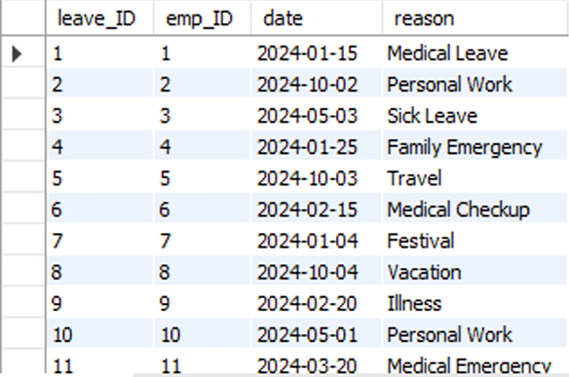
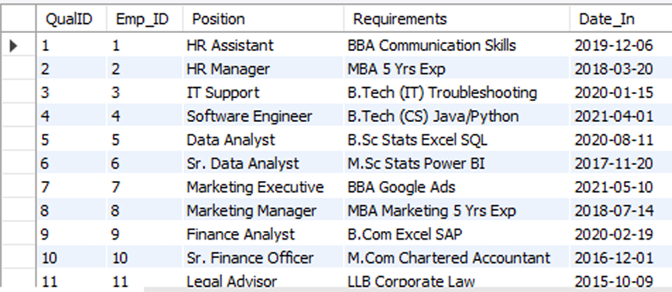
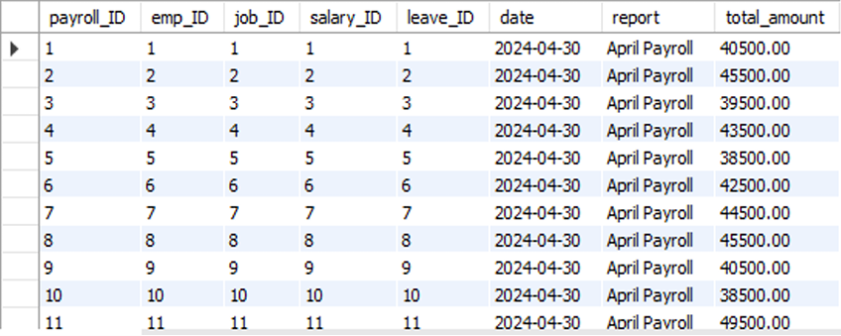
Leaves
Qualification
Payroll

Slide 8
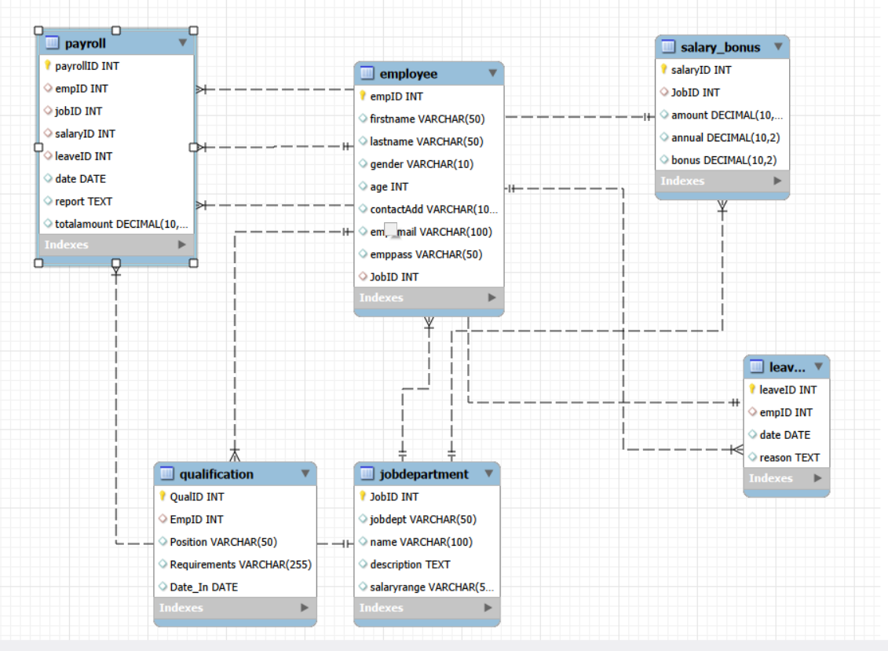
ER Diagram & Schema Explanation

Slide 9
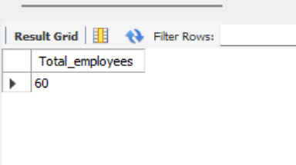
Analysis Questions
EMPLOYEE INSIGHTS
● How many unique employees are currently in the system?

Slide 10
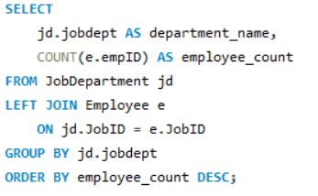
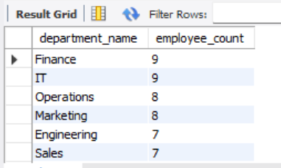
Which departments have the highest number of employees?

Slide 11
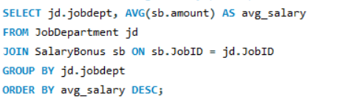
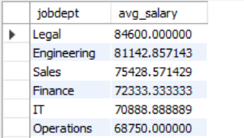
What is the average salary per department?

Slide 12
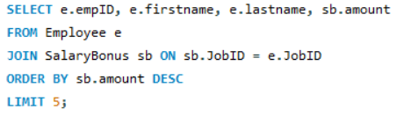
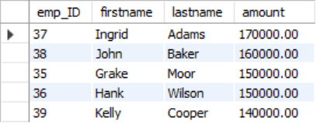
Who are the top 5 highest-paid employees?

Slide 13

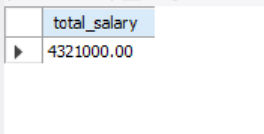
What is the total salary expenditure across the company?

Slide 14
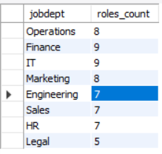
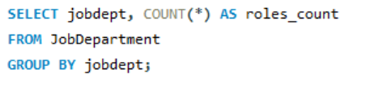
2. JOB ROLE AND DEPARTMENT ANALYSIS ● How many different job roles exist in each department?

Slide 15
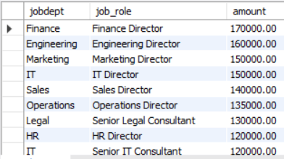
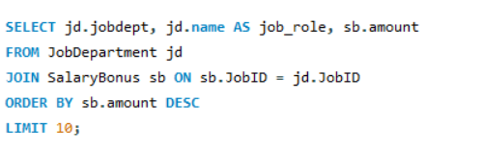
Which job roles offer the highest salary?

Slide 16
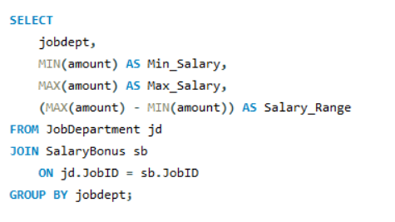
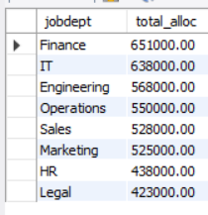
Which departments have the highest total salary allocation?

Slide 17
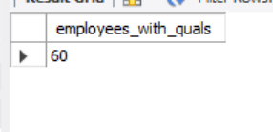
3. QUALIFICATION AND SKILLS ANALYSIS ● How many employees have at least one qualification listed?

Slide 18
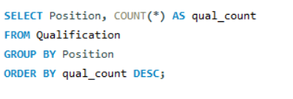
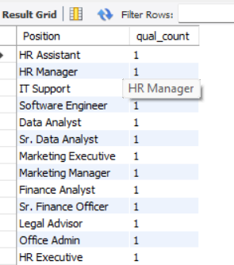
Which positions require the most qualifications?

Slide 19
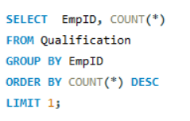
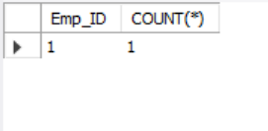
Which employees have the highest number of qualifications?

Slide 20
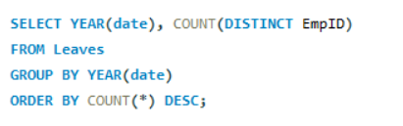
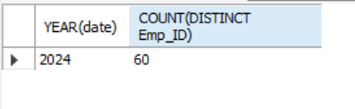
4. LEAVE AND ABSENCE PATTERNS ● Which year had the most employees taking leaves?

Slide 21
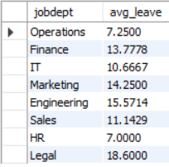
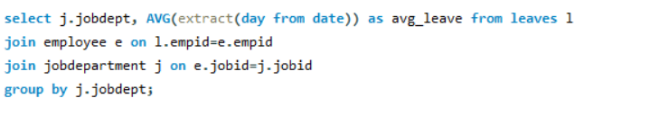
What is the average number of leave days taken by its employees per department?

Slide 22
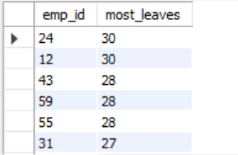
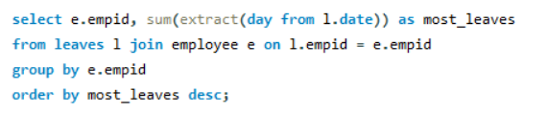
Which employees have taken the most leaves?

Slide 23
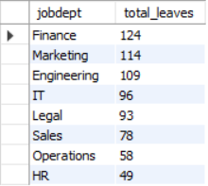
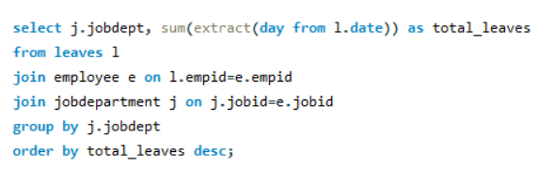
What is the total number of leave days taken company-wide?

Slide 24
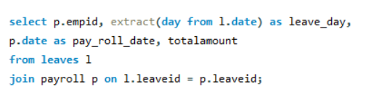
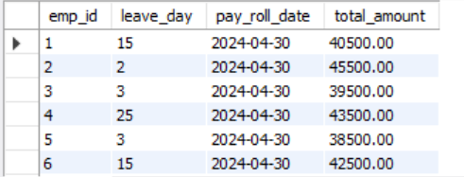
How do leave days correlate with payroll amounts?

Slide 25
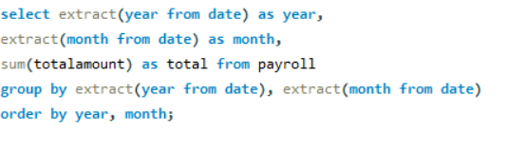
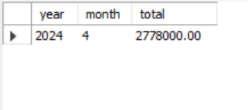
5. PAYROLL AND COMPENSATION ANALYSIS ● What is the total monthly payroll processed?

Slide 26
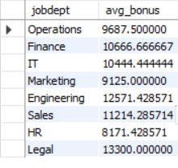
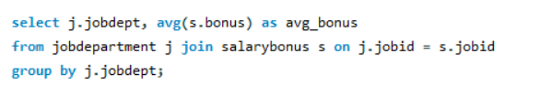
What is the average bonus given per department?

Slide 27
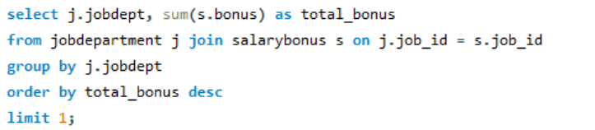
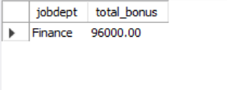
Which department receives the highest total bonuses?

Slide 28
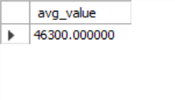
What is the average value of total_amount after considering leave deductions?

Slide 29
Final Business Insights & Recommendations
Key Insights
Departments with more employees tend to have higher salary expenditure.
Certain job roles offer higher salaries and bonuses, influencing employee retention.
Leave patterns reveal workload stress or seasonal trends.
Payroll variations reflect bonuses, leave deductions, and job hierarchy.
Recommendations
Optimize resource allocation in departments with high salary expenditure.
Offer training programs for roles requiring high qualifications.
Implement better leave management practices to reduce productivity impact.
Automate payroll to minimize manual errors and speed up processing.

Slide 30
Challenges Working on SQL Project
Designing the ER diagram and establishing correct foreign key connections was challenging initially.
Writing multi-table JOIN queries required understanding relationships between tables.
Ensuring data consistency during inserts, updates, and deletes needed careful planning.
Handling date formats and generating time-based insights took additional effort.
Overall, the project improved my SQL understanding, query optimization skills, and analytical thinking.

Slide 31
Conclusion
The Employee Management System successfully demonstrates how SQL can organize and analyze large employee datasets. Through ER modeling, structured tables, and complex queries, the system provides valuable insights for HR decision-making, salary planning, and performance tracking. The project highlights the importance of relational databases in efficient workforce management.
,

Slide 32

THANK YOU

